Slide 1
CHAPTER 5
Multivariate Probability Distributions

Slide 2
OBJECTIVES
Expected Value of a Function of Random Variables
Properties of Expected Value

Slide 3
Expected Value of a Function of Random Variables
Any function h(X) of a single rv X is itself a random variable.
However, to compute E[h(X)], it is not necessary to obtain the probability distribution of h(X).
Instead, E[h(X)] is computed as a weighted average of h(x) values, where the weight function is the pmf p(x) or pdf f (x) of X.
A similar result holds for a function h(X, Y) of two jointly distributed random variables.

Slide 4
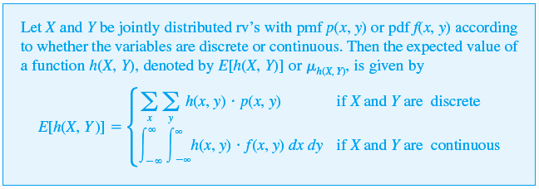
Expected Value of a function of RV

Slide 5
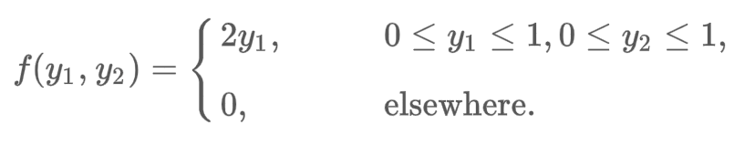
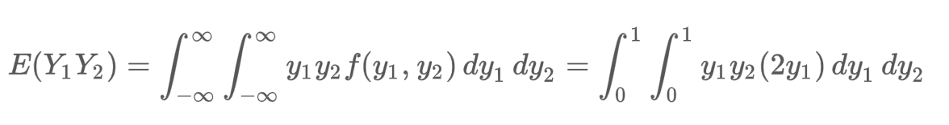
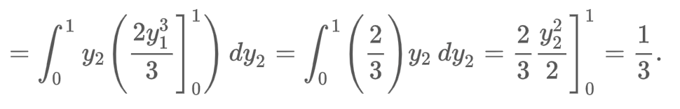
Example
Let Y₁ and Y₂ have joint density given by
Find E(Y₁Y₂).
Sol:

Slide 6
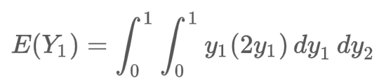
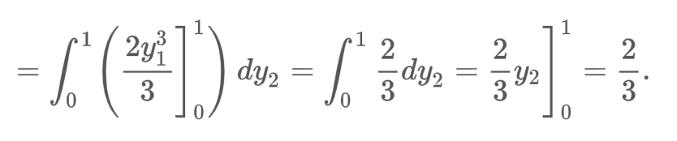
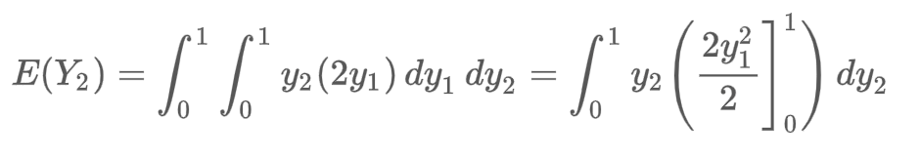
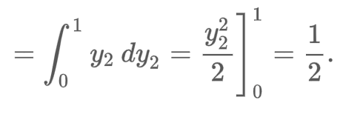
Example cont’d
Find E(Y₁) and E(Y₂).
Sol:

Slide 7

Example
The joint distribution of Y₁, the number of contracts awarded to firm A, and Y₂, the number of contracts awarded to firm B, is given by the entries in the following table. Find E(Y₁-Y₂).

Slide 8

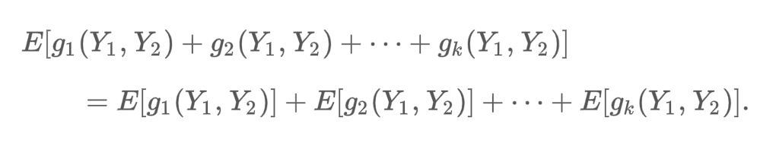
Properties of Expected Value
Let c be a constant. Then E(c) = c
Let g(Y₁, Y₂) be a function of the random variables Y₁ and Y₂ and let c be a constant. Then
Let Y₁ and Y₂ be random variables and g₁(Y₁, Y₂), g₂(Y₁, Y₂), …, g_{k}(Y₁, Y₂) be functions of Y₁ and Y₂ . Then

